Slide 1
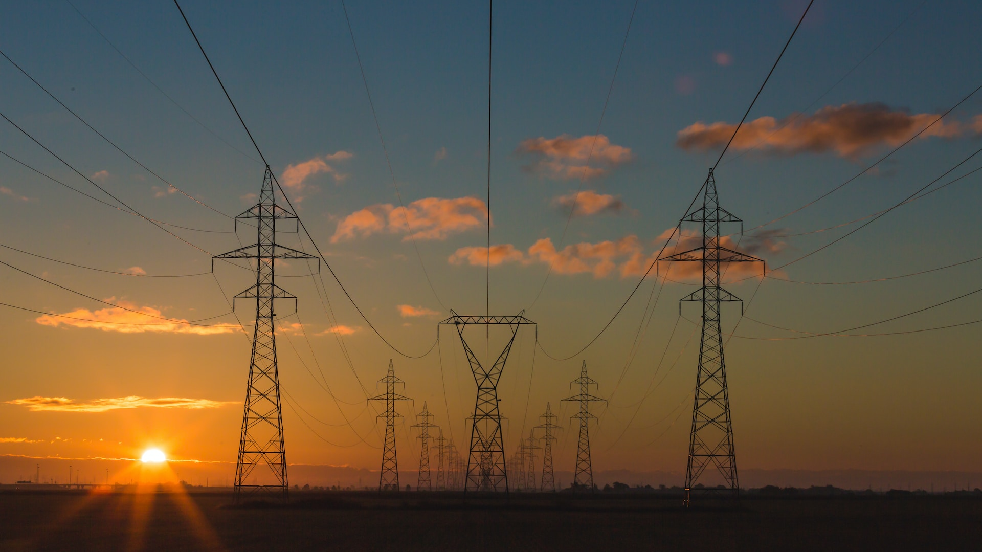
Global Energy Consumption - Navigating the Path to Sustainability
Team Members & Role:
Amankumar Bhatu​
Rohan Mistry​
Rishabh Panchal​
Tanay Shah
Date: 04 December 2023

Slide 2
About Our Project
Welcome to the "Global Energy Consumption – Navigating the path to Sustainability" project, a comprehensive exploration of the changing landscape in global energy trends. This initiative scrutinizes the dynamic shift from traditional fossil fuels to the emerging era of renewable energy sources. Through meticulous data analysis encompassing key factors like population, GDP, and various energy consumption metrics, this project aims to provide a nuanced understanding of how nations worldwide are embracing sustainable practices. Join us on this journey as we unravel insights, trends, and implications shaping the future of global energy consumption.
This project navigates the intricate web of data to uncover insights across diverse nations, examining their unique trajectories in the pursuit of sustainable energy solutions. From biofuel and coal consumption to renewable sources like wind and solar, our analysis offers a panoramic view of how countries are diversifying their energy portfolios. As we traverse the nuances of electricity generation, greenhouse gas emissions, and economic indicators, this presentation aims to illuminate the global energy landscape, providing a holistic perspective on the ongoing paradigm shift towards a more environmentally conscious and resilient future.

Slide 3
Problem Statement
Temporal Overview of Global Energy Consumption
Examining the total energy consumption worldwide between 1980 and 2022 to elucidate trends, shifts, and pivotal events that have shaped the evolving energy landscape, with a focus on identifying patterns for informed future energy strategies.
Transitioning from Fossil Dependency
Investigating the global shift away from fossil fuel consumption to discern evolving patterns, drivers, and challenges, shedding light on the transformative journey towards more sustainable and resilient energy sources.
Global Renewable Energy Uptake
Analyzing the patterns and trends of renewable energy consumption worldwide to uncover insights into the adoption rates, regional variations, and contributing factors, with the goal of informing strategies for a more sustainable and renewable future.

Slide 4
Data Source
Our World in Data - Energy
Hannah Ritchie, Max Roser and Pablo Rosado (2023) - “Energy” Published online at OurWorldInData.org. Retrieved from: 'https://ourworldindata.org/energy' [Online Resource]
https://github.com/owid/energy-data
Future Energy Targets by Country
U.S. Energy Information Administration (EIA) - https://www.eia.gov/
Germany - https://www.bmwk.de/Navigation/EN/Home/home.html
Natural Resources Canada - https://natural-resources.canada.ca/home
Japan - https://www.meti.go.jp/english/

Slide 5
Data Source
Data Characteristics
Timeline covered : 1980-2022
Worldwide data but limited by certain information
Details
Columns : 113
Rows : 11,138
Energy Sectors Covered
Fossil Fuels – Coal, Oil & Gas
Renewables – Wind, Solar, Hydro, Biofuel
Other - Nuclear
Details
Columns : 113
Rows : 11,138

Slide 6
Data Cleaning
Eliminated columns that did not align with the project's problem statement.
Rectified null values in Population and GDP by adjusting their respective entries across multiple fields.
Excluded aggregated data pertaining to combined countries.
Incorporated overall world data values into the dataset.
Aligned empty fields with a standardized value of zero.

Slide 7
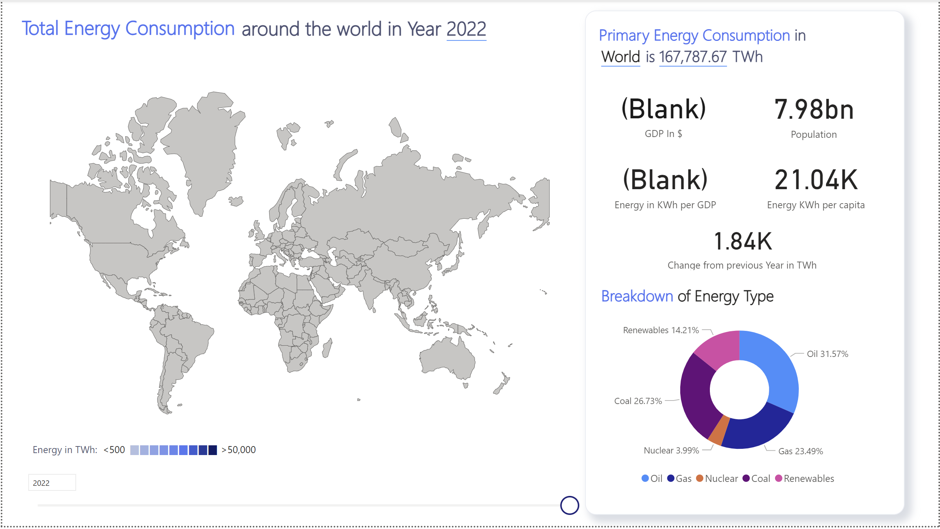
How much energy does the world consume?
Insights:
Total Word Consumption: 167,788 terawatt-hours
On average, each individual worldwide consumes approximately 21,000 kilowatt-hours of energy.
The consumption increased by 1,800 terawatt-hours from the previous year

Slide 8
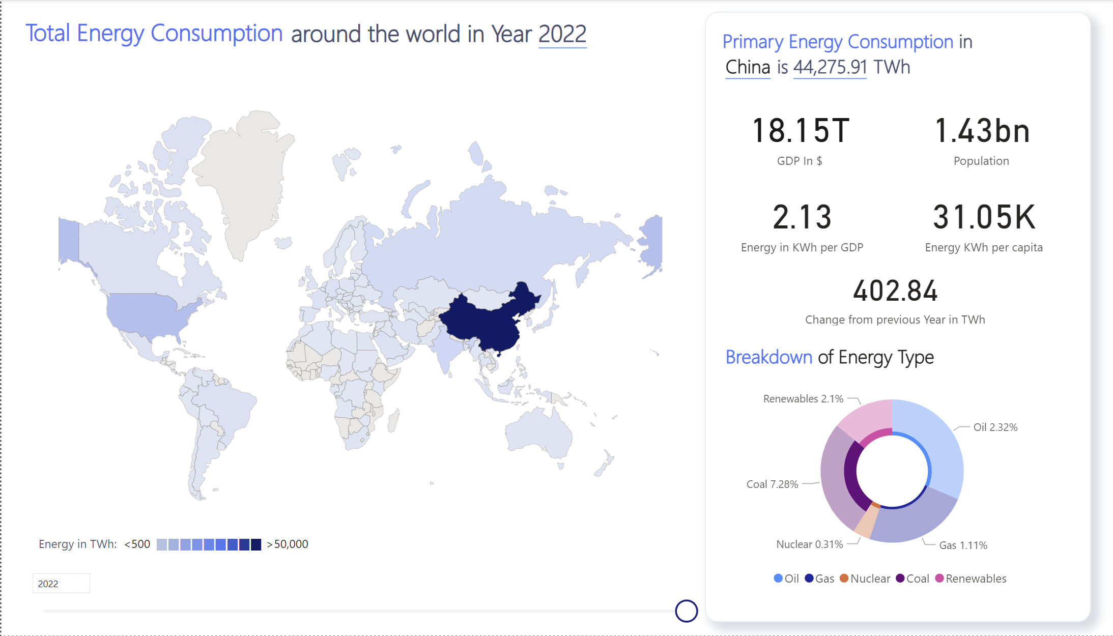
Which country tops in energy consumption?
Insights:
China ranks as the top global consumer of energy, with a total consumption of 44,276 terawatt-hours.
On average, each individual in China consumes approximately 31,000 kilowatt-hours of energy. And Ranks 7th in per-capita consumption

Slide 9
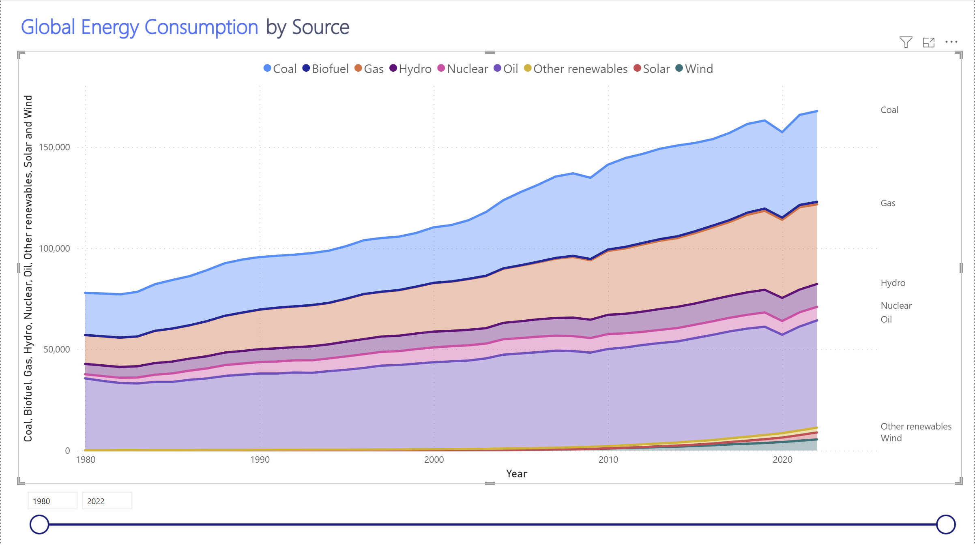
Global energy consumption by source
Insights:
Coal and oil are the largest sources of energy consumption, with coal being the largest source in recent years. This indicates a heavy reliance on fossil fuels for energy.
Other sources such as hydro, nuclear, and other renewables are present but in smaller quantities. However, wind and solar energy consumption have increased in recent years, indicating a shift towards cleaner energy sources.

Slide 10
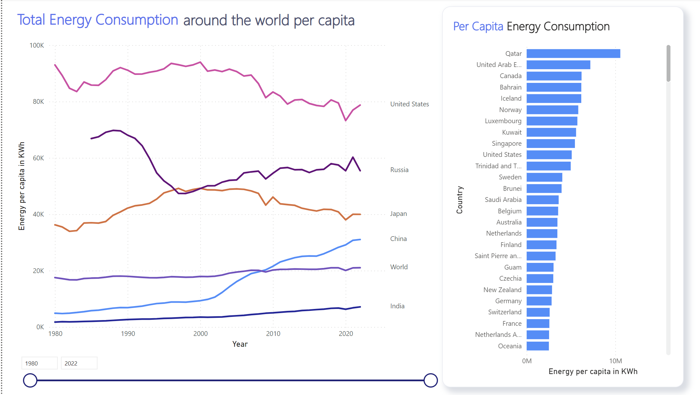
Per capita Energy Consumption
Insights :
Among high-consumption nations such as the US, Russia, China, and India, the United States boasts the highest per capita consumption, with Russia following closely behind.
Globally, Qatar and the UAE exhibit the highest per capita consumption followed by Canada.

Slide 11
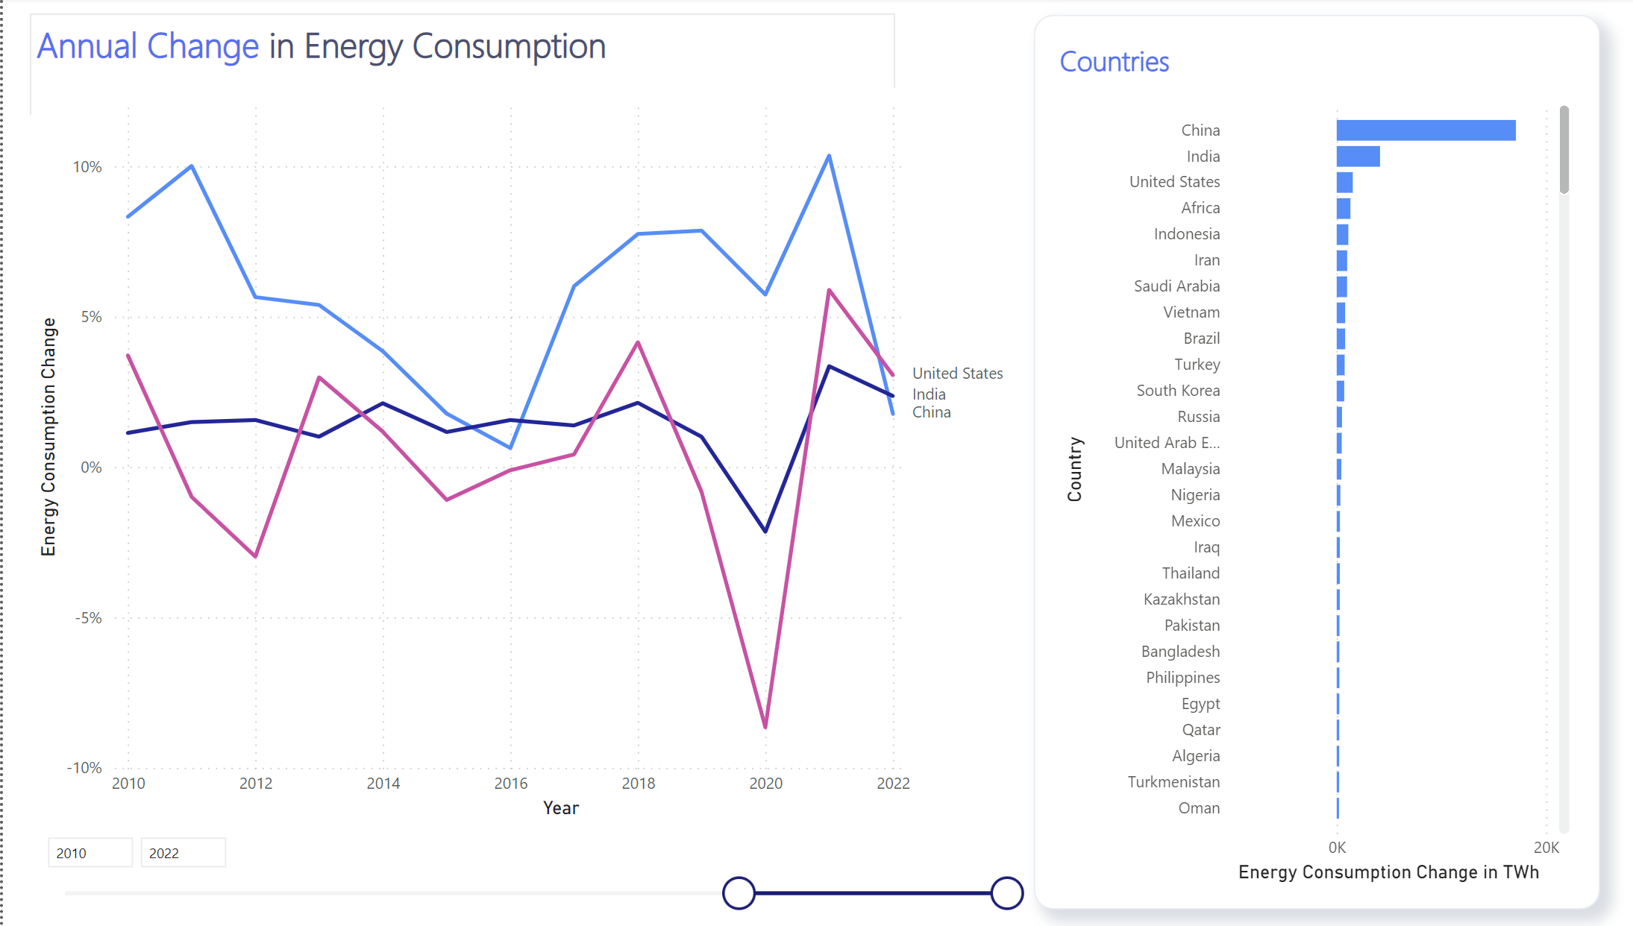
Annual Changes in Consumption
Insights:
Globally, the primary energy consumption varies every year. However, in wealthier countries actively working towards enhancing energy efficiency, there is a decline in energy consumption
A global observation during the COVID-19 pandemic was a decrease in consumption in every country when compared to the preceding and subsequent years.

Slide 12
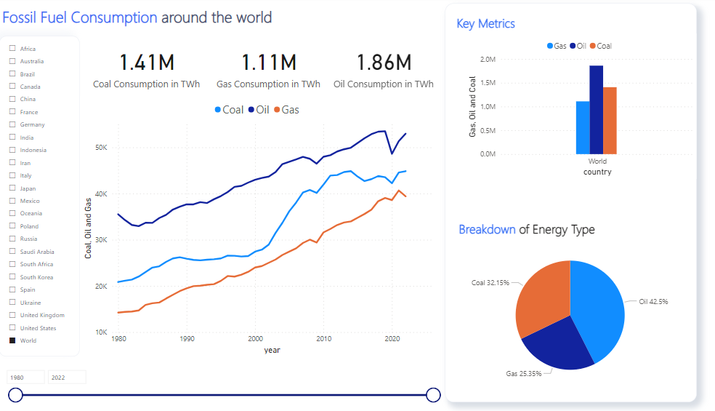
Fossil fuel consumption Analysis
Insights:
Shifting landscape
Oil's Unyielding Demand
Decadal Dynamics

Slide 13
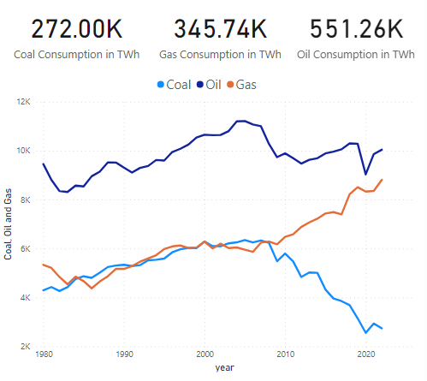
US cutting down the coal usage
Insights:
Oil Consumption Stability
Decline in coal Usage
Gas's Steady Rise and Role in Transition.
Diversification Efforts for Sustainable Energy

Slide 14
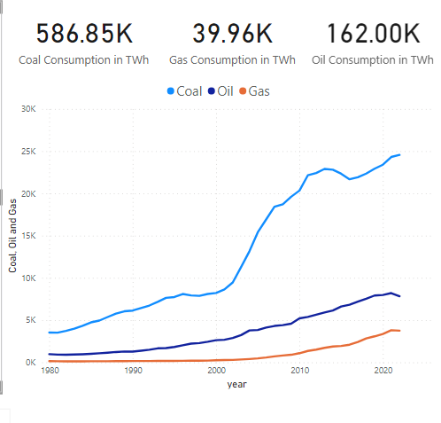
which countries use Coal The most ?
Insights: China
Steady Increase in Energy Consumption
Rise in coal usage

Slide 15
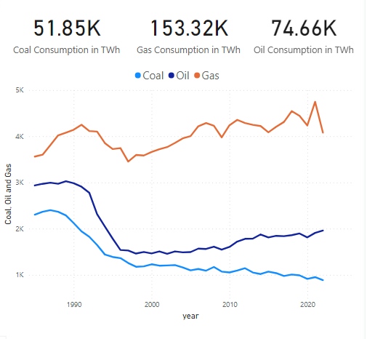
Which country dominates Gas usage?
Insights:
Russia Dominates the Gas usage .
Decline in usage of coal and oil after 1995.

Slide 16
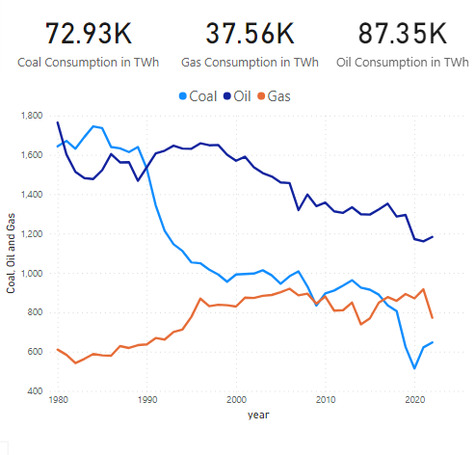
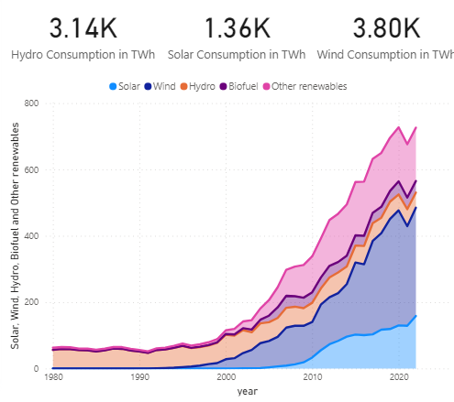
Germany's Decline in fossil fuel Usage
Insights:
Germany's Decline in fossil fuel Usage
Shifting into Renewable source of energy after 2000s

Slide 17
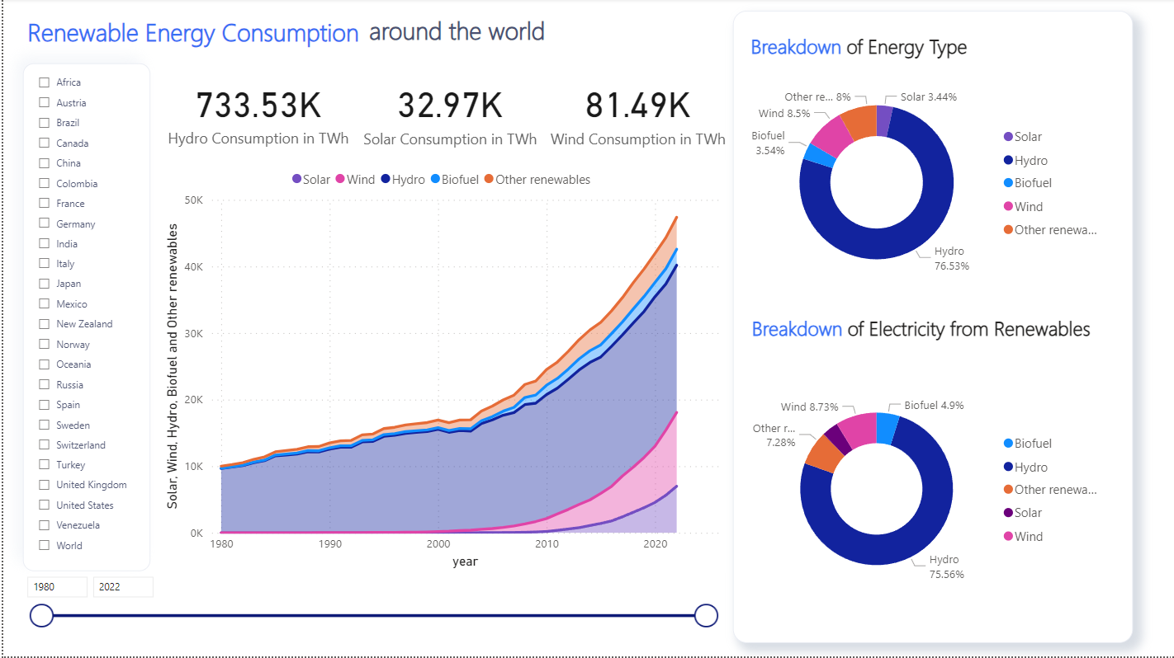
Cue – Renewable Energy

Slide 18
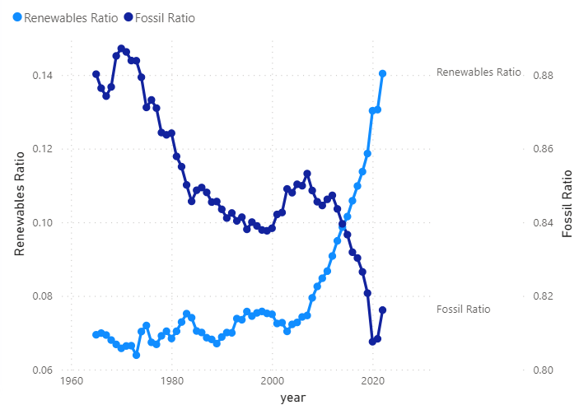
Cue – Renewable Energy
Renewable Ratio = Renewable_Consumption/
Total_Primary_Consumption
Fossil Ratio = Fossil_Consumption/
Total_Primary_Consumption

Slide 19
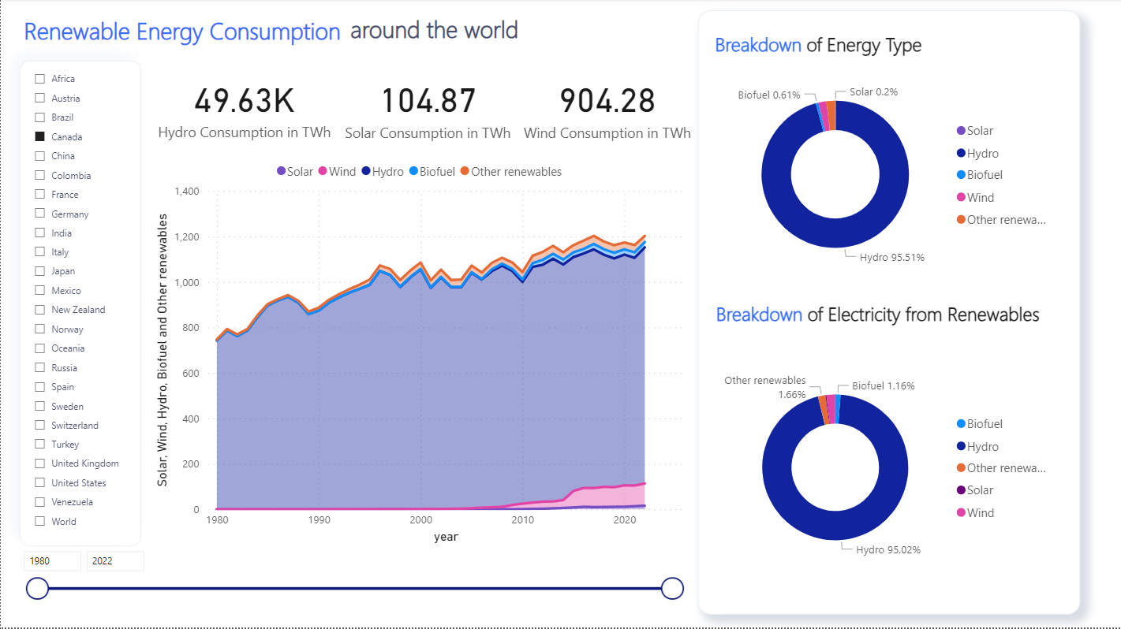
What is the Progress of Countries?
Canada
Insights:
Historically and presently, Canada is primarily dependent on hydropower in the renewable energy sector with over 85% of electricity produced from Hydropower in 2022.

Slide 20
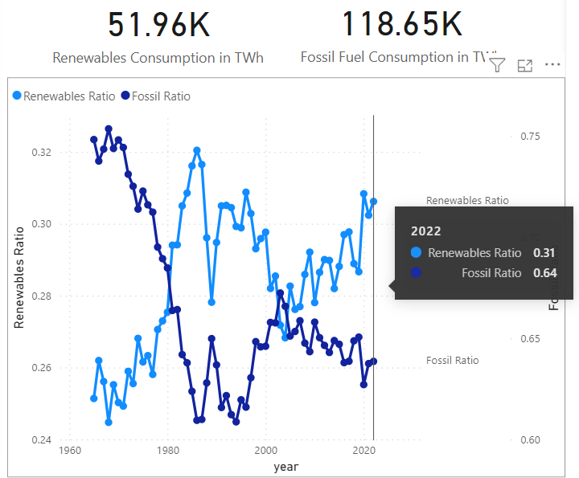
What is the Progress of Countries?
Canada
Insights:
Historically and presently, Canada is primarily dependent on hydropower in the renewable energy sector with over 85% of electricity produced from Hydropower in 2022.

Slide 21
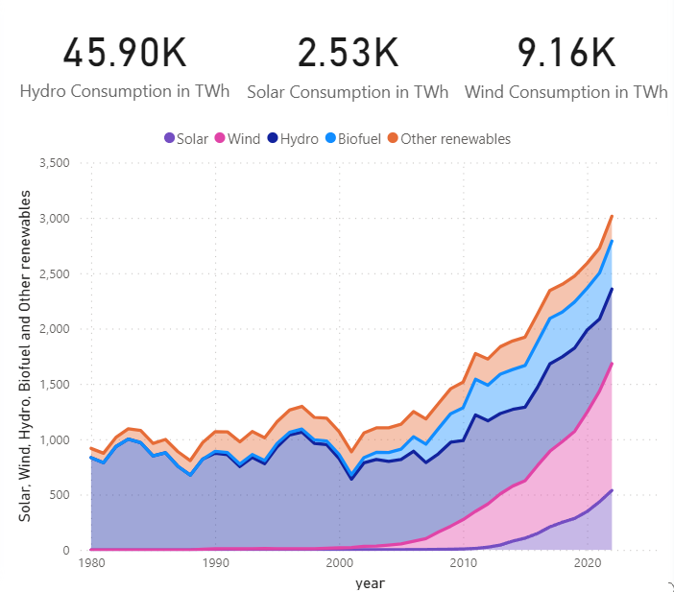
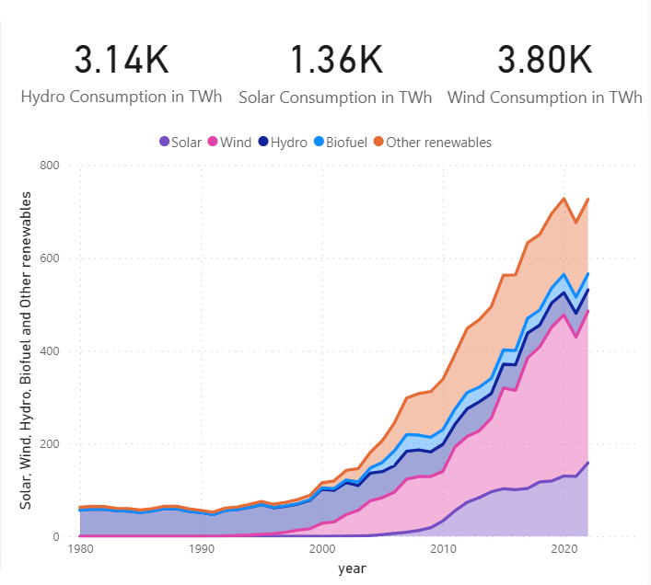
What is the Progress of Countries?
United States
Germany

Slide 22
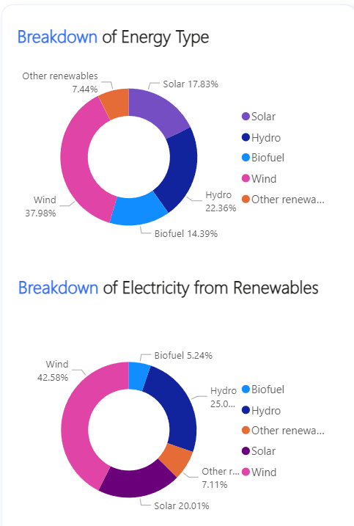
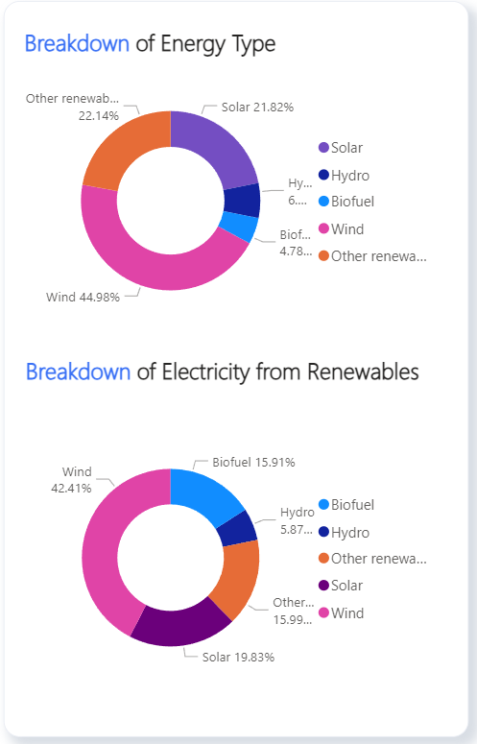
What is the Progress of Countries?
United States 2022
Germany 2022

Slide 23
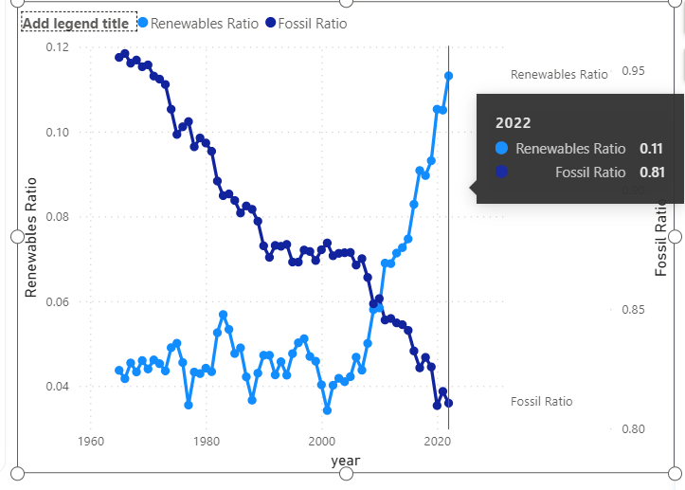
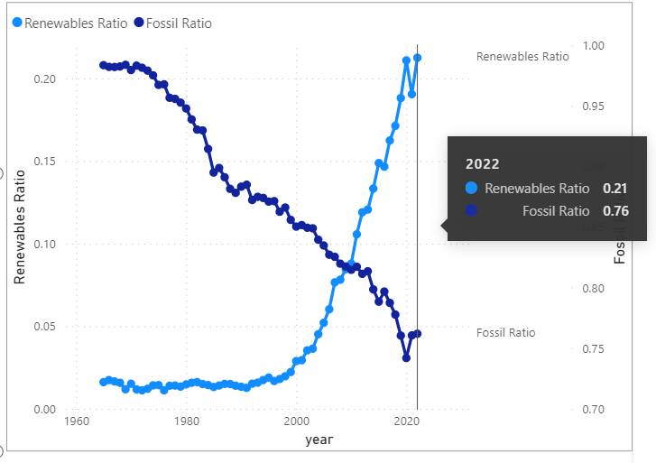
What is the Progress of Countries?
United States
Germany

Slide 24
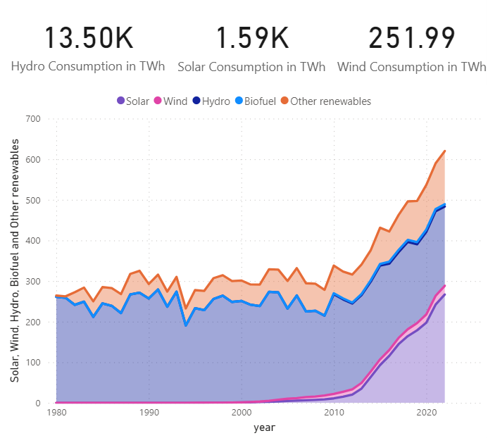
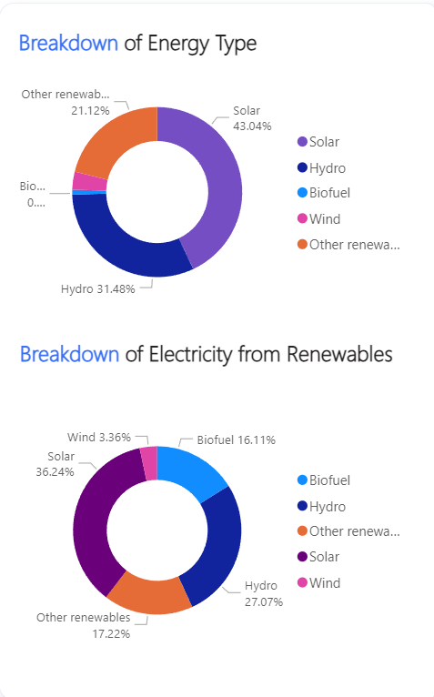
What is the Progress of Countries?
Japan
2022
Insights:
Japan has seen a tremendous growth in solar energy sector

Slide 25
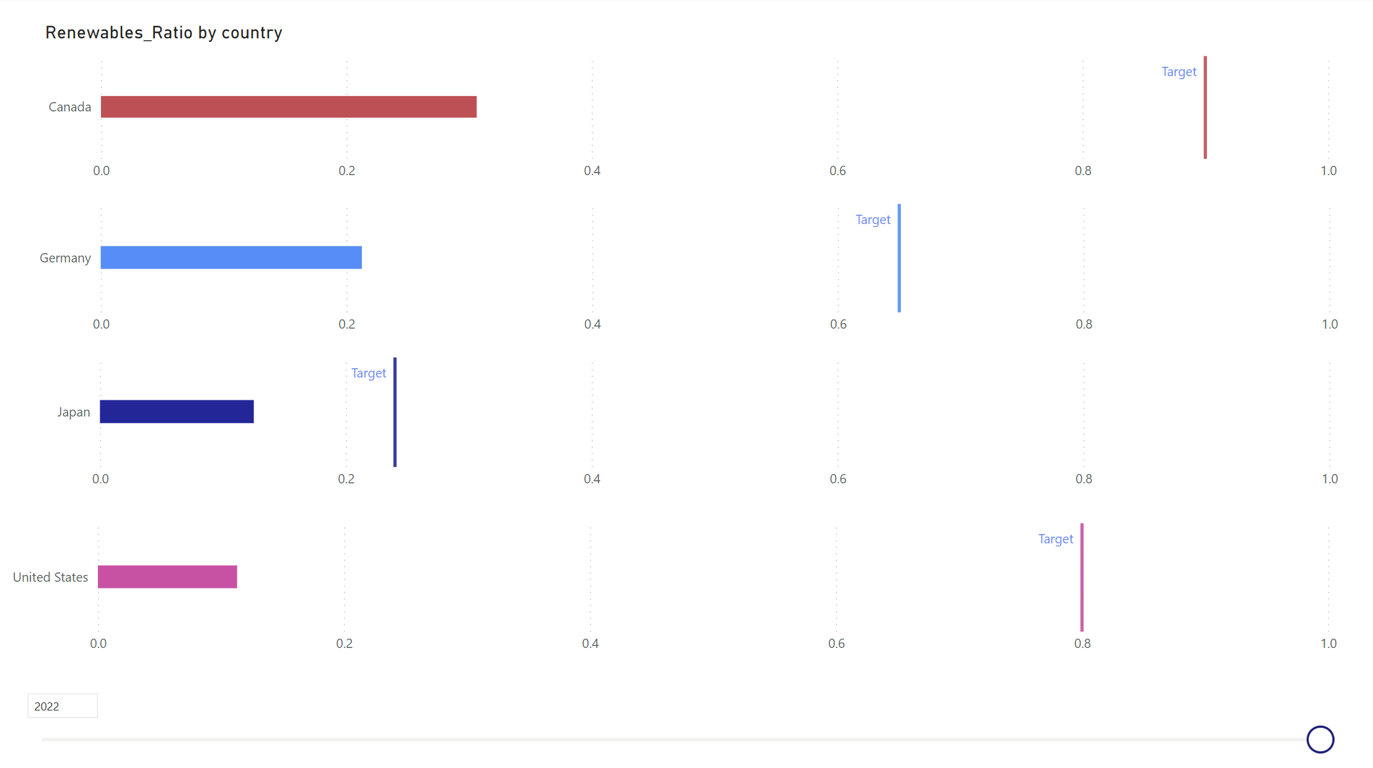
Will the World Make it?

Slide 26
Challenges
Predictive Modelling
We developed a model to predict the consumption values for year 2025.
However, due to less values available, for each country, the model predicted incorrect values.

Slide 27
THANK YOU !

